Slide 1
Pass-by-value vs Pass-by-reference
Pass-by-value: Here, a copy of the actual parameters (i.e. their values) is supplied to the formal parameters. Thus any modification of these parameter is not reflected outside of the procedure(function). That is, a change in value of one of the parameters inside the procedure is local to that procedure(function).
Pass-by-reference: Here, the formal parameters are bound to the reference values of the actual parameters. This means that a change in the value of a parameter inside the procedure will actually change the value contained in the variable to which that parameter refers. Thus, a change in the value of a parameter inside the procedure is not local to that procedure(function).

Slide 2
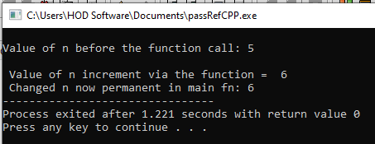
//A C++ code demonstrating pass by reference using pointer
#include <iostream>
using namespace std;
int main()
{
int n;
int increment(int *ptrn);
n=5; //n is set to 5
cout<<"\nValue of n before the function call: "<<n;
cout<<"\n\n Value of n increment via the function = "<<increment(&n); // passing the //address of n
cout<<"\n Changed n now permanent in main fn: "<<n;
return 0;
} //end of main
//function definition
int increment(int *ptrn)
{
*ptrn = *ptrn+1; //altering n by adding 1...the change is permanent everywhere
return *ptrn;
}

Slide 3
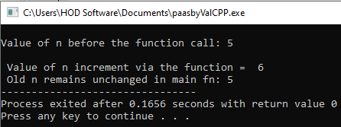
//A C++ code demonstrating pass by value
#include <iostream>
using namespace std;
int main()
{
int n;
int increment(int nformal);
n=5; // n is set to 5
cout<<"\nValue of n before the function call: "<<n;
cout<<"\n\n Value of n increment via the function = "<<increment(n);
cout<<"\n Old n remains unchanged in main fn: "<<n;
return 0;
} //end of main
//function definition
int increment(int nformal)
{
nformal = nformal + 1; //change the value only in this function
return nformal;
}

Slide 4
NOTE on ARRAY and Pointers:
Elements of a one-dimensional array are stored in consecutive memory locations. To access elements of such array of data, we need to know the address of the first element of the array and so an addition of the simple suffices determines the address of an arbitrary element of the array.
If A[i] is one of the elements in the array named A, then:
A (base address) (Base address also stands for the address of the first element in the array i.e. &A[0]). It means fetch A is also fetching &A[0].
i (index)
A[i] (array element A[i])
The concept of arrays is related to that of pointers.
The array name itself denotes the base address of the array, that is, arrays work very much like pointers to their first elements. This means that ampersand (&) is not needed to assign the address of an array to a pointer.
myptr= myarray;
But if you have to use &, since it’s the address of the first element that is needed you write it as:
myptr= &myarray[0]; // same as myptr= myarray;

Slide 5
NOTE on ARRAY:
// code example…
#include <iostream>
using namespace std;
int main()
{
int myarray[5];
int *myptr;
myptr= myarray;
// line 7 is same as myptr= &myarray[0];
//read in values into array
cout<<"\n accept values into array using pointer: ";
for(int i = 0;i<5; i++)
{
cout<<"\nEnter Value: "<<i+1<<"of the array";
cin>>*myptr;
myptr++;
}
cout<<"\n myarray address"<<myarray;
cout<<"\n myarray[0] value "<<myarray[0];
cout<<"\n myarray[0] address "<<&myarray[0];

